Slide 1
INVESTIGATING THE INFLUENCE OF PUBLIC HEALTH EXPENDITURES ON AVERAGE LIFE EXPECTANCY AND MORTALITY RATES IN THE USA
Surya S S

Slide 2
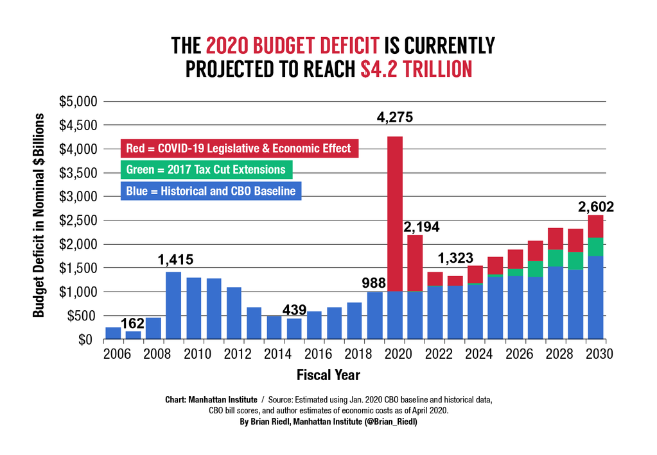
INTRODUCTION
Life expectancy at birth is a critical indicator of a population's overall health and well-being. It reflects the combined effects of various factors, including access to healthcare, socioeconomic conditions, and public health interventions.
Soaring medical costs often spark heated debates about resource allocation and, particularly, the efficacy of public health spending in improving population health. This project delves into this crucial debate by investigating the potential link between public health expenditures and Mortality trends in the United States.
Our primary motivation is to provide evidence-based insights that can inform policymakers and public health officials on the effectiveness of public health investments in mitigating Mortality risks and guide future resource allocation decisions.
Reference Link

Slide 3




WHO WILL BE BENIFITTED
POLICY MAKERS
HEALTH CARE ADMINISTRATORS
RESEARCHERS
GENERAL PUBLIC
Informed Budget
Decisions
Resource Optimization, Efficient Delivery
Valuable Health
Outcome Insights
Enhanced Healthcare,
Longer Lives

Slide 4

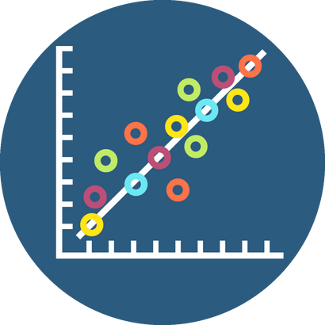

RESEARCH QUESTIONS
How does Average Life Expectancy and Mortality vary between different Races and Genders?
Is there a significant correlation between National Health Expenditure and Life Expectancy , Mortality?
Can past National Health Expenditure help us predict future expenses?

Slide 5


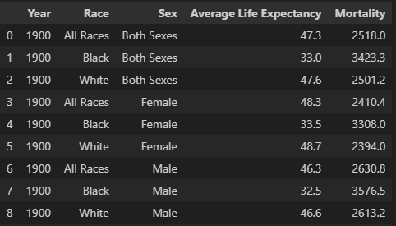
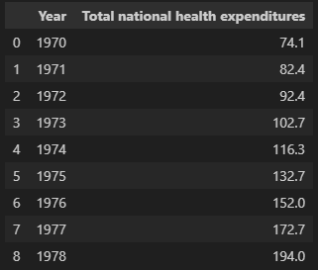
DATA SOURCE
NCHS Web API: Life expectancy & Mortality in the U.S. (1900 - 2020)
Peterson-KFF CSV : Public health expenditure ( 1970 to 2021)

Slide 6




RESEARCH APPROACH
Exploratory Data Analysis
Data Preparation
Investigative Analysis
Additional Features
Perform Univariate, bivariate, and multivariate analysis to uncover trends and relationships.
Merging Datasets, Data Cleaning , Feature Engineering for deeper analysis
Correlation and predictive analysis to answer the research questions
Employ OOPS Concepts, Interactive Visualizations using Plotly

Slide 7


KEY INSIGHTS FROM EDA
Understanding the Data:
The Race column is comprised of 3 distinct categorical values All Races, Black and White.
The Sex column is comprised of 3 distinct categorical values Both Sexes, Male and Female.
Average Life Expectancy at birth for an individual is 64
Average Mortality rate is 1616.
Average National Health Expenditure id 1436 Billion USD
Trends Over Time:
Positive life expectancy trend, possibly due to improved healthcare.
Decreasing Mortality rates over the years, linked to advanced healthcare.
Consistent increase in U.S. government healthcare funding, enhancing facilities.
Demographic Disparities:
White females have higher life expectancy; black males face elevated Mortality.
Data Gaps:
Absence of average life expectancy and Mortality data for white males beyond 1947.

Slide 8



DATA PREPARATION METHODS
Merging Data:
Merged two datasets into single DataFrame covering all races and genders from 1970 to 2018.
Cleaning Data:
Observed null values in "life_expectancy“. Imputated the null values with previous years data, considering the existing trend.
Created dummy variables for simplified analysis and modeling.
Addressing Data Gaps:
A critical data gap exists for "White Males” post-1947, impacting life expectancy and mortality rate information.
Used data of “White Both Sex” and “White Female” to estimate and fill the missing values.

Slide 9
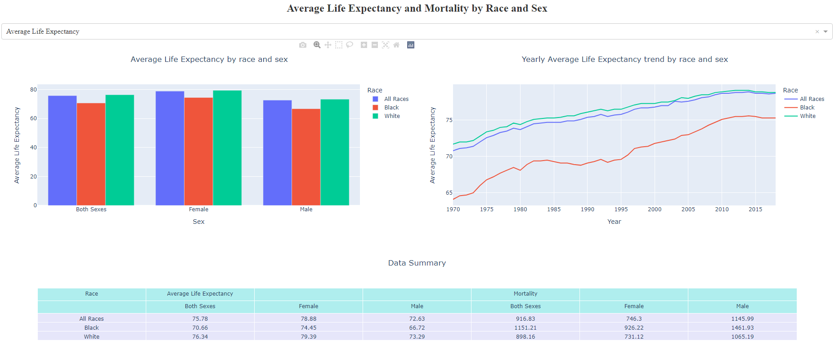

How does Average Life Expectancy and Mortality vary between different Races and Genders?
Approach: Aggregated data at different levels and used Plotly to create an interactive dashboard to visualize the demographic disparity of Average Life Expectancy and Mortality.
Insights: Black individuals, regardless of gender, exhibit the highest Mortality rates. White individuals, irrespective of gender, demonstrate higher life expectancy.
Interactive Feature: We can use the dropdown to toggle the visuals between Average Life Expectancy and Mortality.

Slide 10
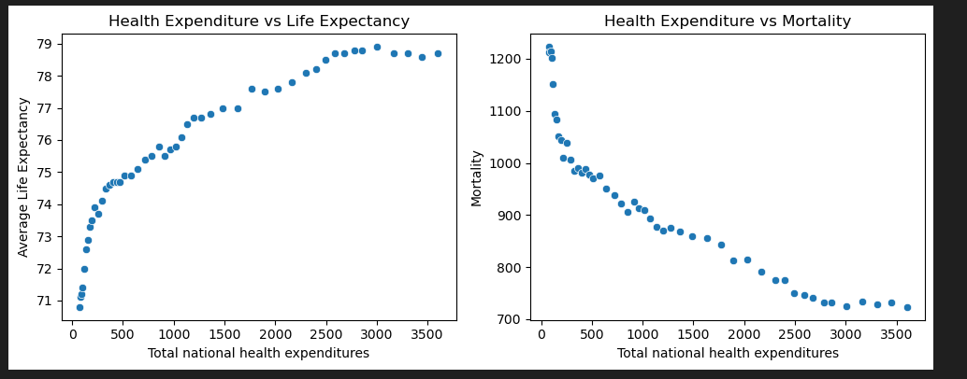
Is there a significant correlation between National Health Expenditure and Life Expectancy , Mortality?
Approach:
Used the merged data and perform correlation analysis between National Health Expenditure and Life Expectancy , Mortality
Insights:
Positive correlation between increased Health Expenditure and improved life expectancy, Mortality rates.
Upward trend in life expectancy and simultaneous decline in Mortality rates over the Years.

Slide 11
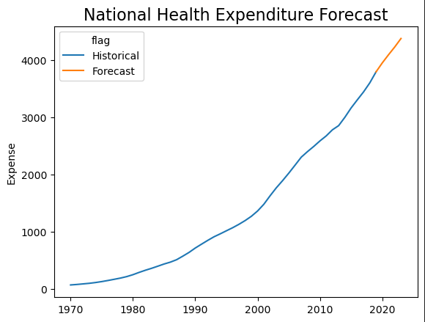

Can past National Health Expenditure help us predict future expenses?
Approach:
Used ARIMA model to forecast National Health Expenditure values.
Insights:
Our model forecasts an upward trend in National Health Expenditure.
Model Evaluation:

Slide 12
CONCLUSION
Key Findings:
Demographic disparities: Black individuals, regardless of Sex, have the highest Mortality rates, while white individuals have the highest life expectancy.
Correlation Analysis: Increased national healthcare expenditure correlates with improved life expectancy and reduced Mortality rates.
Predictive modelling: Future Public Health Expenditures are projected to increase, suggesting positive trends in life expectancy.
Recommendations:
Conduct Public awareness campaigns to educate men on preventive care, and healthy lifestyles.
Targeted funding to address health concerns of underserved communities .
Research on disparities to Understand root causes and develop effective interventions.
Future Extensions:
Explore additional demographic factors to improve the data granularity.
Investigate on confounding variables that could have influenced the results

Slide 13
Questions?

Slide 14


